Slide 1
Smart Water bottle
Presented By : The Assembly Team

Slide 2

Why make it Smart?
With a busy schedule, drinking water usually goes unnoticed.

Slide 3
Plan
Assemble the electronics
Code the arduino
Make an app to monitor the water level, temperature and a reminder to stay hydrated.

Slide 4

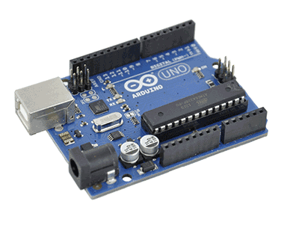
Components that we are using today

Slide 5
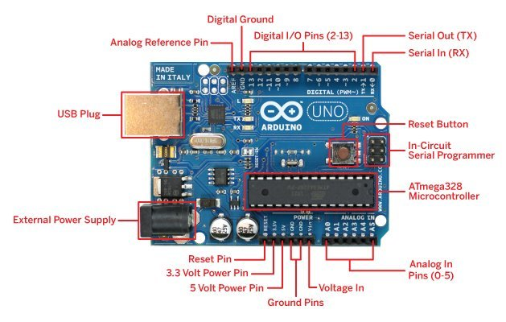
Arduino UNO
Notes:
Arduino UNO- https://www.arduino.cc/en/Main/ArduinoBoardUno/ ; http://forefront.io/a/beginners-guide-to-arduino/
There are three pools of memory in the microcontroller used on avr-based Arduino boards :
Flash memory (program space), is where the Arduino sketch is stored.
SRAM (static random access memory) is where the sketch creates and manipulates variables when it runs.
EEPROM is memory space that programmers can use to store long-term information.
Flash memory and EEPROM memory are non-volatile (the information persists after the power is turned off). SRAM is volatile and will be lost when the power is cycled.

Slide 6
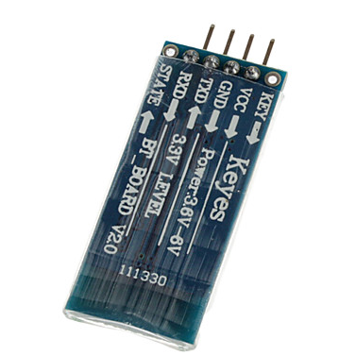
HC-06 (Bluetooth module)
Notes:
Read more http://www.fecegypt.com/uploads/dataSheet/1480849570_hc06.pdf
Tutorial - http://www.instructables.com/id/Add-bluetooth-to-your-Arduino-project-ArduinoHC-06/
*AT mode can be activated to change the default settings of the Bluetooth module
●Bluetooth module
●Bluetooth radio to serial convertor for wireless communication
●In telecommunication and data transmission, serial communication is the process of sending data one bit at a time, sequentially, over a communication channel or computer bus
●HC-06 module only can only be used as a slave component. Eg: wireless serial bridge
●Key pin used to activate the AT mode
●RXD: Serial input pin
●TXD Serial output pin
●State pin shows the Bluetooth connection status
●Bluetooth vs wifi
●Bluetooth is one of the technology which connected mobile devices wirelessly. Bluetooth have very short range when compared to WiFi. With the help of Bluetooth, you could send data and voice but in Wi-Fi you can't. Bluetooth is secure because it uses two step authentication process and it is point to point connection and you can connect only one device with Bluetooth. Bluetooth uses very less power, and it is more versatile, you can connect your smartwatch,speaker, headset, mobiles etc..

Slide 7
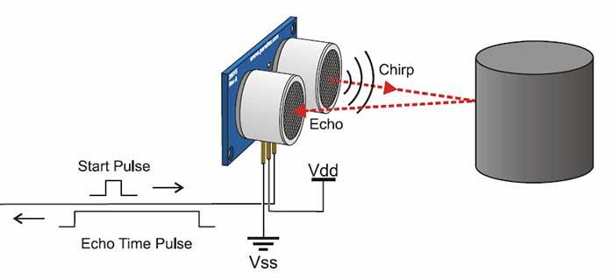
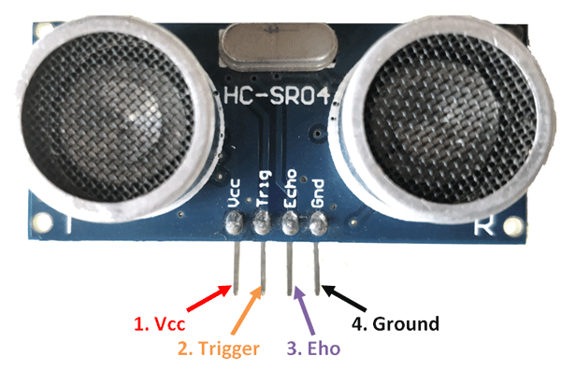
Ultrasonic Sensor
Notes:
Read more https://www.bjultrasonic.com/ultrasonic-technical-info/how-do-ultrasonic-sensors-work/
Example with Arduino: http://howtomechatronics.com/tutorials/arduino/ultrasonic-sensor-hc-sr04/

Slide 8
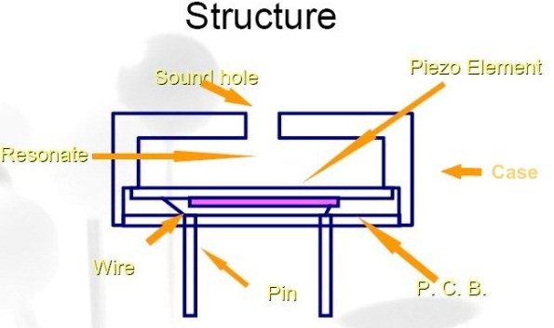
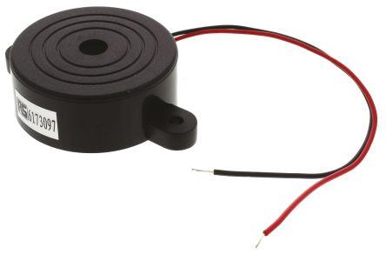
Piezo Buzzer
Notes:
Read more http://www.futureelectronics.com/en/passives/buzzers.aspx
Tutorial - http://www.instructables.com/id/How-to-use-a-Buzzer-Arduino-Tutorial/
*Piezo electricity - phenomena of generating electricity when mechanical pressure is applied to certain materials and the vice versa is also true. Such materials are called piezoelectric materials. Piezoelectric materials are either naturally available or manmade.
*Piezoceramic disks - Piezoceramic is class of manmade material, which poses piezo electric effect and is widely used to make disc, the heart of piezo buzzer. When subjected to an alternating electric field they stretch or compress, in accordance with the frequency of the signal thereby producing sound.

Slide 9
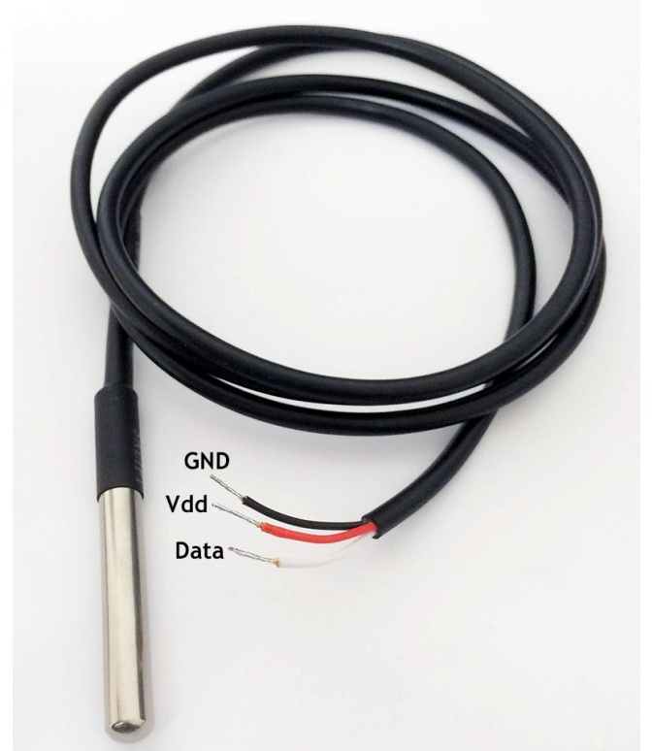
Temperature Sensor
Notes:
Read more https://www.adafruit.com/product/381
Tutorial - https://create.arduino.cc/projecthub/TheGadgetBoy/ds18b20-digital-temperature-sensor-and-arduino-9cc806

Slide 10
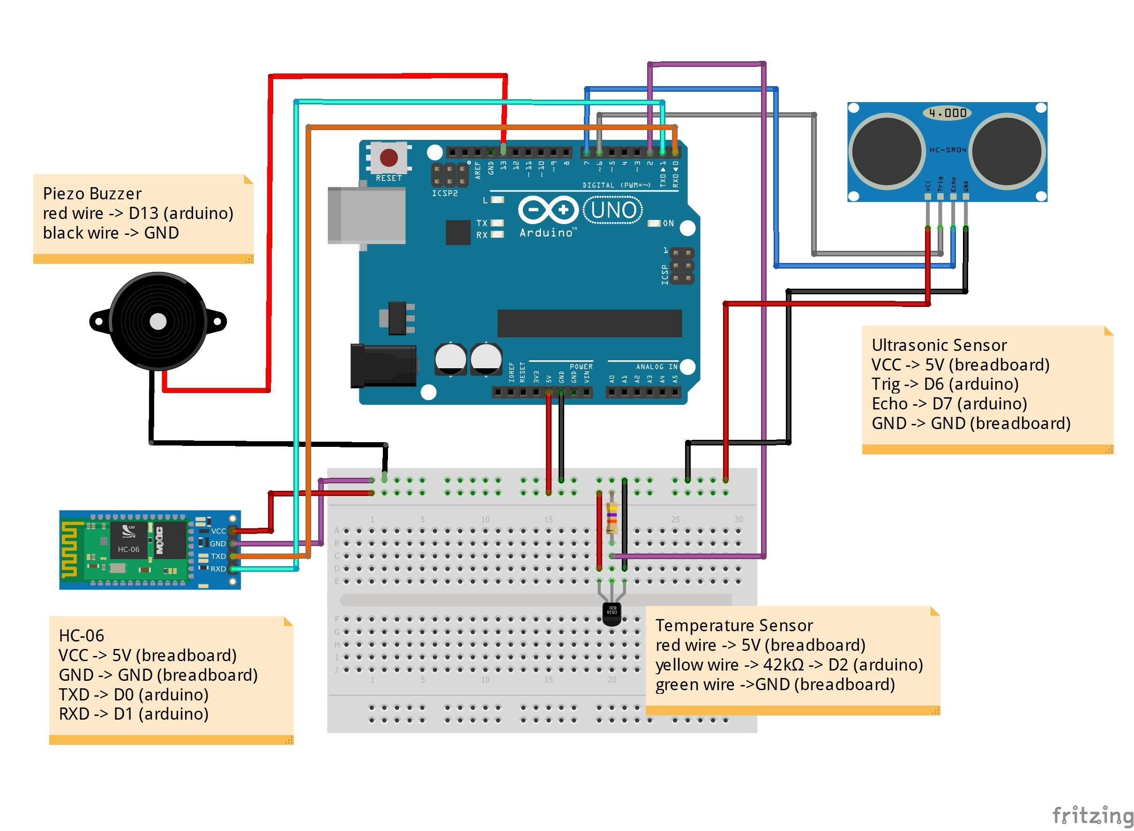
Implementing the entire system

Slide 11
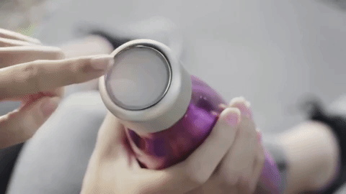
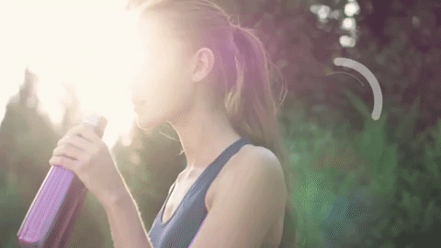
Moikit Smart Water bottle

Slide 12
Code
Arduino
Open the bottle_arduino.ino code using the Arduino IDE.
Install the OneWire.h and DallasTemperature.h libraries
Plug out the RX and TX wires before uploading the code to arduino. Plug them when done.

Slide 13
Continuation...
App
Download the smart_bottle.apk file to your mobile phone.
If you want to make the app from scratch, please visit http://ai2.appinventor.mit.edu/
import the smart_bottle.aia file to make any changes to the app if needed

Slide 14
Github repository
To get the instructions and other files go to:
https://github.com/The-Assembly/smart_water_bottle

Slide 15
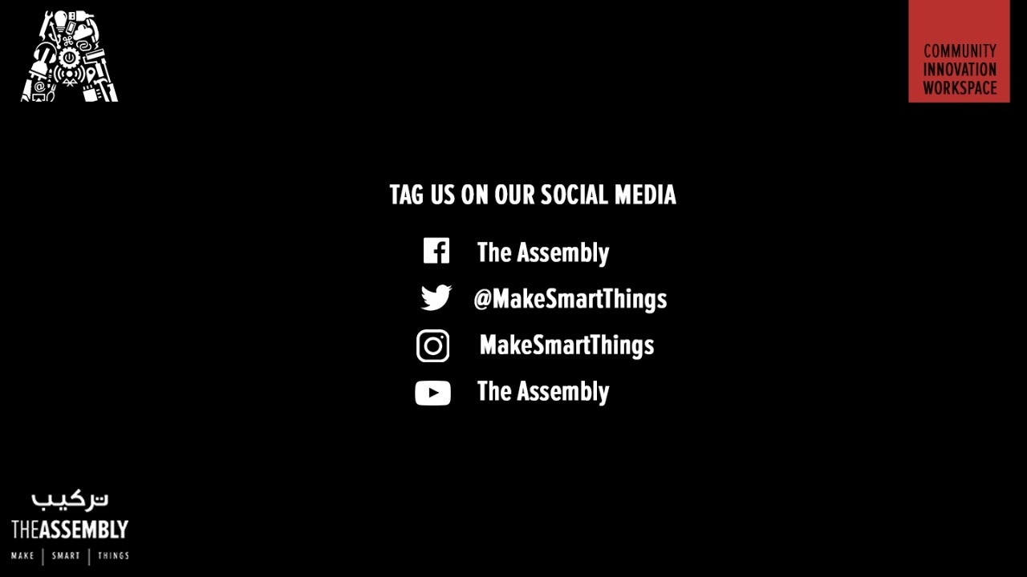
THANK YOU
THANK YOU

